Slide 1

Data Visualization of Bird Strikes between 2000 – 2011
Preeti R

Slide 2


AGENDA
Sl No | Topics
3 | Introduction
4 | Case Studies
5 | Visualizing Bird Strike Frequency
6 | Yearly Analysis: Bird Strikes in the United States
7 | Bird Strike Analysis of US Airlines & Airports
8 | Yearly Cost Incurred Due to Bird Strikes
9 | Altitude Analysis of Bird Strikes in Flight Operations
10 | Weather Conditions And Phase of Flight during Strikes
11 | Impact of Bird Strikes on Flight And Aircraft
12 | Communication with Pilots
13 | Summary
14 | Conclusion

Slide 3
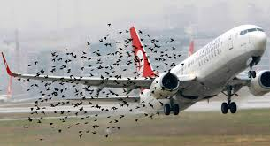
INTRODUCTION
Bird strikes, also known as bird-aircraft collisions (BAC) or bird ingestion, occur when birds collide with aircraft during flight or while on the ground. These incidents pose significant risks to aircraft, passengers, and crew, and they can result in costly damages, delays, and even accidents.
Several factors contribute to the frequency and severity of bird strikes, including bird migration patterns, proximity to airports and bird habitats, and airport management practices. Airports located near bodies of water or open fields are particularly susceptible to bird strikes due to the presence of birds attracted to these environments.
To reduce the risks associated with bird strikes, airports, and aviation authorities implement various measures, including bird control programs, habitat management, radar systems to detect bird activity, and aircraft design modifications to enhance bird strike resistance. Additionally, pilots are trained to respond appropriately to bird strike incidents, such as executing emergency procedures and making safe landings.

Slide 4
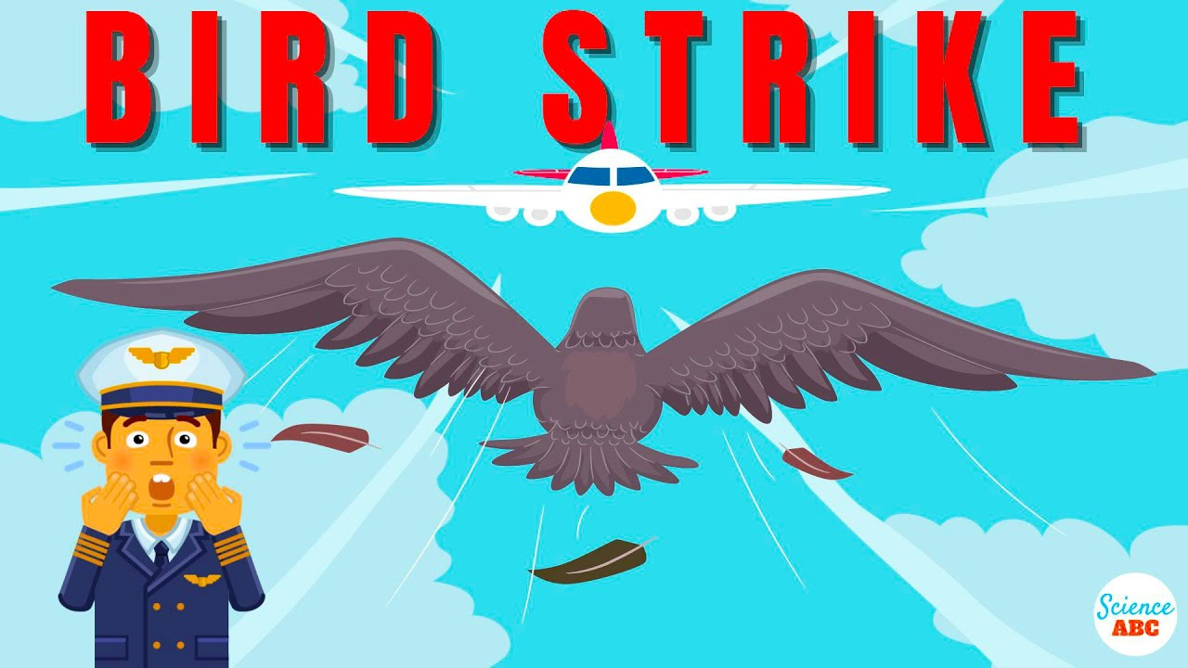
Case Studies
● Visuals Depicting the Number of Bird Strikes
● Yearly Analysis & Bird Strikes in the US
● Top 10 US Airlines in terms of having encountered bird strikes
● Airports with most incidents of bird strikes – Top 50
● Yearly Cost Incurred due to Bird Strikes:
● When do most bird strikes occur?
● Altitude of airplanes at the time of the strike
● Phase of flight at the time of the strike.
● Average Altitude of the airplanes in different phases at the time of the
strike
● Effect of Bird Strikes & Impact on Flight
● Effect of Strike at Different Altitude
● Were Pilots Informed? & Prior Warning and Effect of Strike Relation

Slide 5
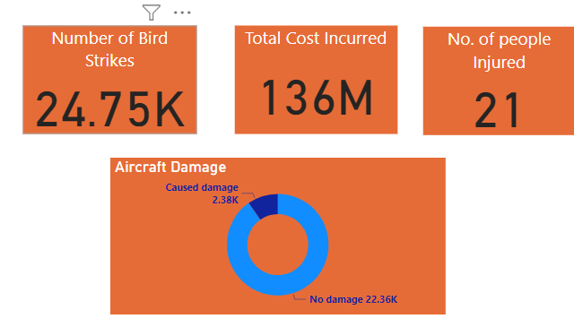
Visualizing Bird Strike Frequency
Incidence:
Out of 24,075 reported bird strikes, the majority, 22,363 cases (90.37%), showed no damage to aircraft, while 2,384 cases (9.63%) resulted in damage.
Additionally, 21 people were injured as a result of these incidents.
Financial Impact:
Aircraft repair costs due to bird strikes amounted to a substantial $136 million, reflecting the significant financial burden associated with these incidents.
Key Takeaways:
Despite the high number of reported bird strikes, the majority resulted in no damage to aircraft. However, the financial burden of repair costs underscores the importance of continued efforts to mitigate bird strike incidents.
Additionally, the presence of injuries highlights the potential human safety risks associated with bird strikes, emphasizing the importance of proactive safety measures and vigilance.

Slide 6
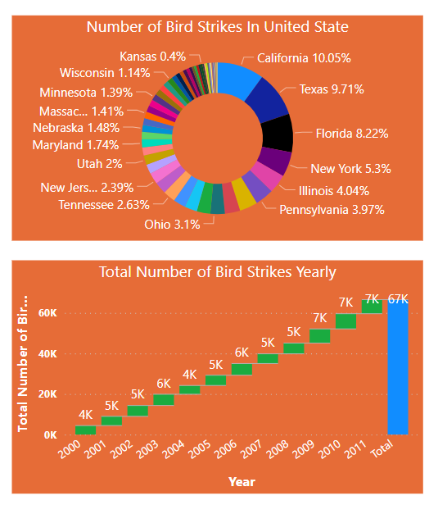
Yearly Analysis: Bird Strikes in the United States
Trending Increase:
From 2000 to 2011, the number of bird strikes increased by 56.50%, indicating a growing concern for aviation safety.
Between 2006 and 2011, there was a significant jump of 20.41%, reaching a peak of 6,939 incidents, highlighting a more recent surge in bird strike occurrences.
Geographic Distribution:
California recorded the highest number of bird strikes, with 2,486 incidents, emphasizing the need for enhanced safety measures in high-risk areas.
Other states such as Texas and Florida also experienced notable strikes, suggesting a widespread issue across different regions.
Surprisingly, Saskatchewan had only one reported strike, indicating regional variations in bird strike occurrences.
Importance of Aviation Safety:
The increasing trend of bird strikes underscores the importance of prioritizing aviation safety measures, especially in regions with high incidence rates like California.
Understanding the geographic distribution of bird strikes can aid in the development of targeted mitigation strategies to reduce the risk of bird strikes and enhance overall flight safety.

Slide 7
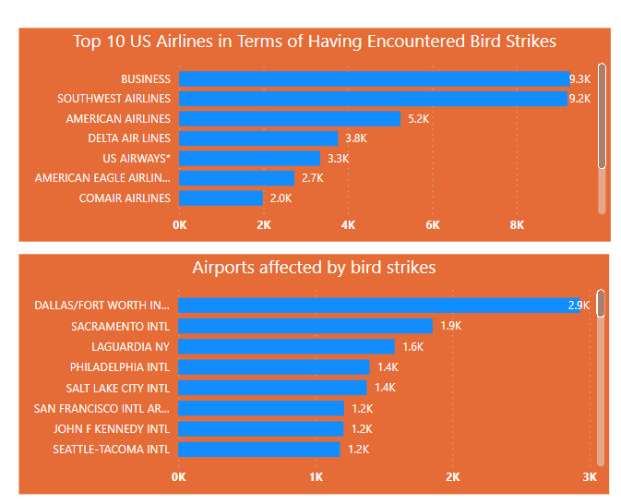
Bird Strike Analysis of Airlines & Airports
Impact on Airlines:
Business airlines, vital for executive travel and cargo transportation, faced a significant risk from bird strikes, with 9,265 incidents accounting for 22.64% of total reported strikes. The susceptibility of these aircraft to bird strikes underscores the potential for operational disruptions and safety concerns.
Impact on Airport :
DALLAS/FORT WORTH INTL ARPT reported the highest number of bird strikes (2,932 incidents), comprising 7.28% of total strikes. This highlights the vulnerability of this airport to bird strike incidents, potentially influenced by its geographic location, nearby habitats, or flight patterns.
Key Insights:
These findings emphasize the importance of implementing proactive measures to mitigate the risks of bird strikes for business airlines operators and airports with high strike rates like DALLAS/FORT WORTH INTL ARPT.
Effective strategies may include the adoption of bird detection technologies, habitat management practices, and comprehensive pilot training programs to enhance bird strike awareness and avoidance, ultimately safeguarding aircraft operations and passenger safety.

Slide 8
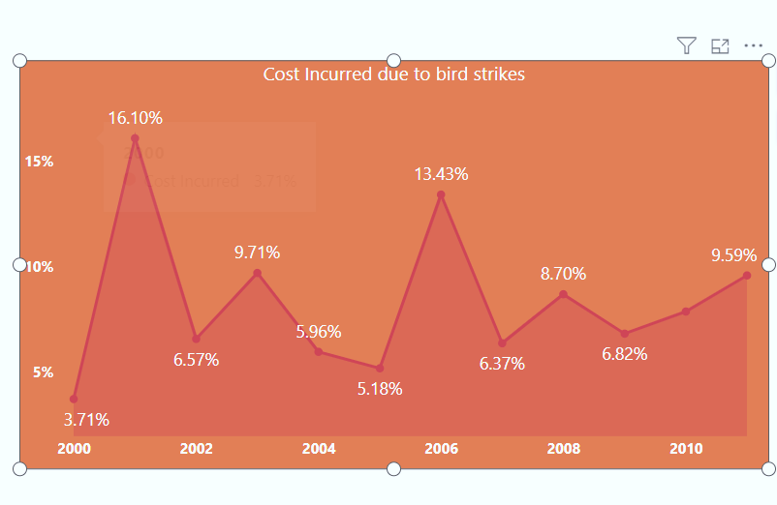
Yearly Cost Incurred Due to Bird Strikes
Variation Over Years:
The cost incurred due to bird strikes varied significantly over the years, ranging from 3.71% to 16.10% of total aviation costs.
Notable fluctuations were observed, with a sharp increase in 2001, reaching 16.10%, and a decrease in 2000, standing at 3.71%.
Financial Impacts:
These fluctuations highlight the financial vulnerability of aviation operations to bird strikes, as they can lead to substantial costs in repair, maintenance, and operational disruptions.
Impact on Operations:
Bird strikes pose a considerable financial risk to airlines and airports, affecting profitability and operational efficiency.
The costs incurred due to bird strikes encompass repair expenses, flight delays, cancellations, and revenue losses.
Key Insights:
Understanding the financial impact of bird strikes underscores the importance of implementing proactive strategies to mitigate their occurrence and manage associated costs effectively.
By investing in bird strike prevention measures and wildlife management programs, aviation stakeholders can enhance safety, minimize financial losses, and ensure uninterrupted flight operations

Slide 9
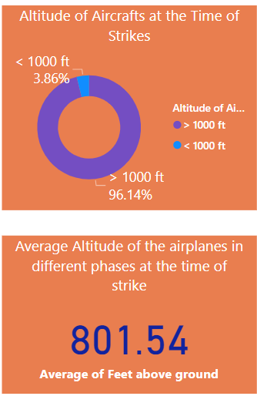
Altitude Analysis of Bird Strikes in Flight Operations
Altitude Analysis:
Aircraft experienced significantly higher average altitudes during bird strikes above 1000 ft (3,560.33 ft) compared to below 1000 ft (142.81 ft), indicating a greater risk at higher altitudes.
This highlights the importance of considering altitude as a factor in bird strike incidents.
Risk Assessment:
Higher altitudes may pose a greater risk of bird strikes due to increased airspace exposure and cruising altitudes during flight.
Understanding altitude trends can help assess the risk of bird strikes and implement targeted safety measures accordingly.
Key Insights:
Flight safety protocols should incorporate awareness of altitude-related bird strike risks, emphasizing the need for vigilance during critical phases of flight.
Pilots and air traffic controllers should be trained to recognize and respond to bird strike threats at various altitudes
Continuous monitoring of altitude trends during bird strike incidents can provide valuable insights for refining safety protocols and enhancing aviation safety standards.

Slide 10
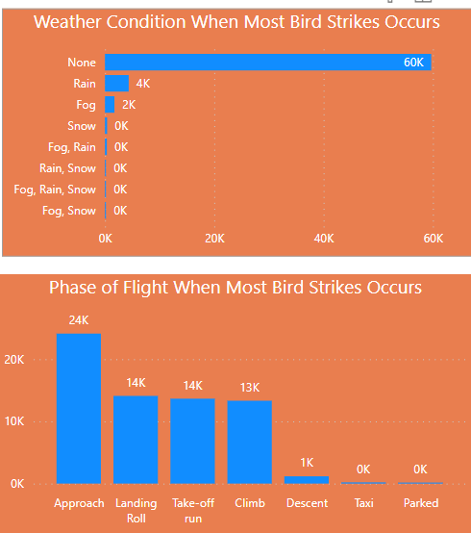
Weather Conditions AND PHASE of FLIGHT during Strikes
Weather Conditions:
Majority of bird strikes (59,695 incidents) occurred in clear weather conditions (None), accounting for 89.70% of all incidents.
Fog and Snow had the lowest occurrences, with only 4 strikes reported. Across all 8 weather conditions, the number of bird strikes ranged from 4 to 59,695.
Phase of Flight:
Most bird strikes (24,111 incidents) happened during the Approach phase, accounting for 36.23% of all strikes.
Parked had the lowest occurrences, with only 12 strikes reported. Across all 7 phases of flight, the number of bird strikes ranged from 12 to 24,111.
Key Insights:
Clear weather conditions pose a significant risk for bird strikes, emphasizing the need for vigilance during such conditions.
Understanding the phase of flight where bird strikes are most likely can help in implementing targeted safety measures to mitigate risks.

Slide 11
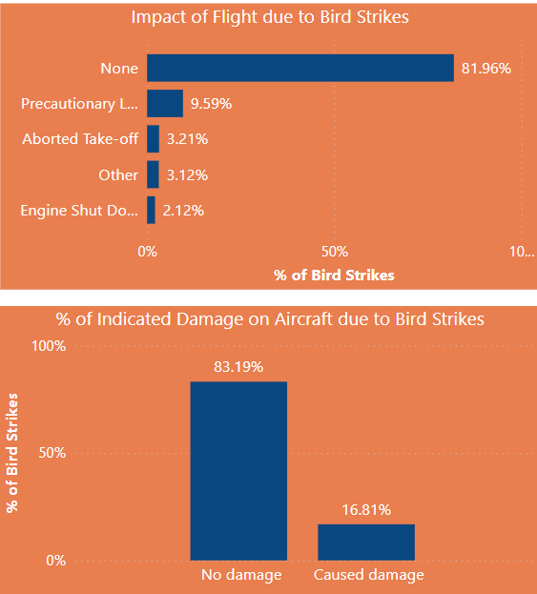
Impact of Bird Strikes on Flight AND AIRCRAFT
Flight Impact:
Majority of bird strike incidents (81.56%) resulted in no significant impact on the flight, categorized as "None."
Precautionary landing was required in 9.59% of cases, while aborted take-off, other impacts, and engine shutdown occurred in 3.21%, 3.21%, and 2.21% respectively.
Damage Incidence:
83.19% of bird strikes did not cause any damage to the aircraft, while 16.81% resulted in damage.
Key Insights:
The majority of bird strike incidents do not lead to flight disruptions or damage to the aircraft, but precautionary measures are still necessary to ensure safety.
Understanding the types of impacts and damage caused by bird strikes can inform better mitigation strategies and maintenance practices.

Slide 12
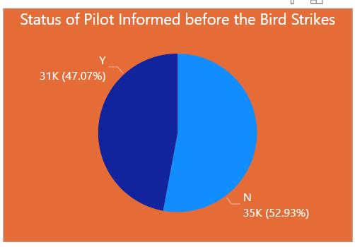
Communication with Pilots
Awareness Trends:
In the majority of cases (52.93%), pilots were not informed before the bird strike, resulting in 35,228 strikes.
Conversely, in 31,323 cases (47.07%), pilots were informed before the bird strike.
Key Insights:
More than half of bird strikes occurred without prior pilot awareness, indicating potential gaps in communication and detection systems.
Improving pilot awareness through enhanced communication and detection systems could lead to more effective response strategies, ultimately enhancing overall flight safety and reducing the frequency of bird strike incidents.

Slide 13


SUMMARY
Bird strikes pose a significant risk to aviation safety, with 52.93% occurring without prior pilot awareness. Despite this, the majority of strikes (81.56%) result in minimal impact on flight operations. Impressively, 83.19% of strikes cause no damage to aircraft, underscoring the effectiveness of safety measures and pilot response. Understanding weather conditions is crucial in developing proactive strategies to mitigate bird strike risks, particularly as clear weather accounts for the majority (59,695 incidents) of reported strikes. This highlights the need for continuous collaboration between aviation stakeholders and wildlife management authorities to ensure safe flight operations and reduce the frequency of bird strike incidents.
​
​

Slide 14
Conclusion
Analyzing bird strike incidents has revealed important insights into their occurrence and impact on flight operations. Clear weather conditions were associated with the majority of strikes, highlighting the need for enhanced vigilance during favorable weather. Despite the frequency of strikes, most did not result in significant flight disruptions or aircraft damage, underscoring the effectiveness of safety measures and pilot response. However, there remains a need for improved pilot awareness and communication systems to mitigate the risks associated with bird strikes. By understanding these patterns and implementing targeted strategies, we can enhance aviation safety and ensure the continued protection of passengers, crew, and aircraft.

Slide 15

THANK
Name - Preeti R​
Email ID-rituganesh01@gmail.com
You

